Slide 1
Locators In Selenium
What are locators?
Basic selenium locators
Implicit and explicit waits
Locating elements using locators
Plugins used for locating elements

Slide 2
Importance of locators
Locators are the address of the specific elements on the webpage, on which the web driver should perform operations like click, send text etc
These are the specific attributes in the html tag which is unique for each component in the web page
Using this locators web driver will move to the specific html tag where the component is present and perform the desired operation
These locators are expected to be unique, in order to make the code unambiguous
In case these locators are not unique, we need to go with the advance locators, which will go with the combination of the attributes and tag and then locate the element

Slide 3
Basic Selenium Locators
Id:
driver.findElement(By.id(“<<id>>”));
Name:
driver.findElement(By.name(“<<name>>”));
Class:
driver.findElement(By.className(“<<class>>”));
Link text
driver.findElement(By.linkText(“<<link>>”));
Partial link text
driver.findElement(By.partialLinkText(“<<part of the link>>”));
css
<tagname>[<attribute>=’value’]
<tagname>.<classname>
<tagname>#<id>
*Note: While using css with class name, we have to make sure that there shouldn’t be any spaces between classses. If there are spaces, we need to remove the spaces and use ‘.’(dot) instead
xpath
//<tagname>[@attribute=’value’]

Slide 4
Basic wait Mechanisms
Implicit wait
Wait defined here is the maximum time to wait for an object to appear
driver.manage().timeouts().implicitlyWait(Duration.ofSeconds(5));
driver.manage().timeouts().implicitlyWait(5,TimeUnit.SECONDS);
Wait applicable for the entire code
Comparitively faster in execution
Explicit wait
Execution will wait for the specified duration
WebDriverWait wait=new WebDriverWait(driver, Duration.ofSeconds(2));
wait.until(ExpectedConditions.invisibilityOfElementLocated(By.cssSelector("input[id*='StudentDiscount']")));
Wait applicable only to the line where it is added
Slow down the execution compared to implicit wait

Slide 5
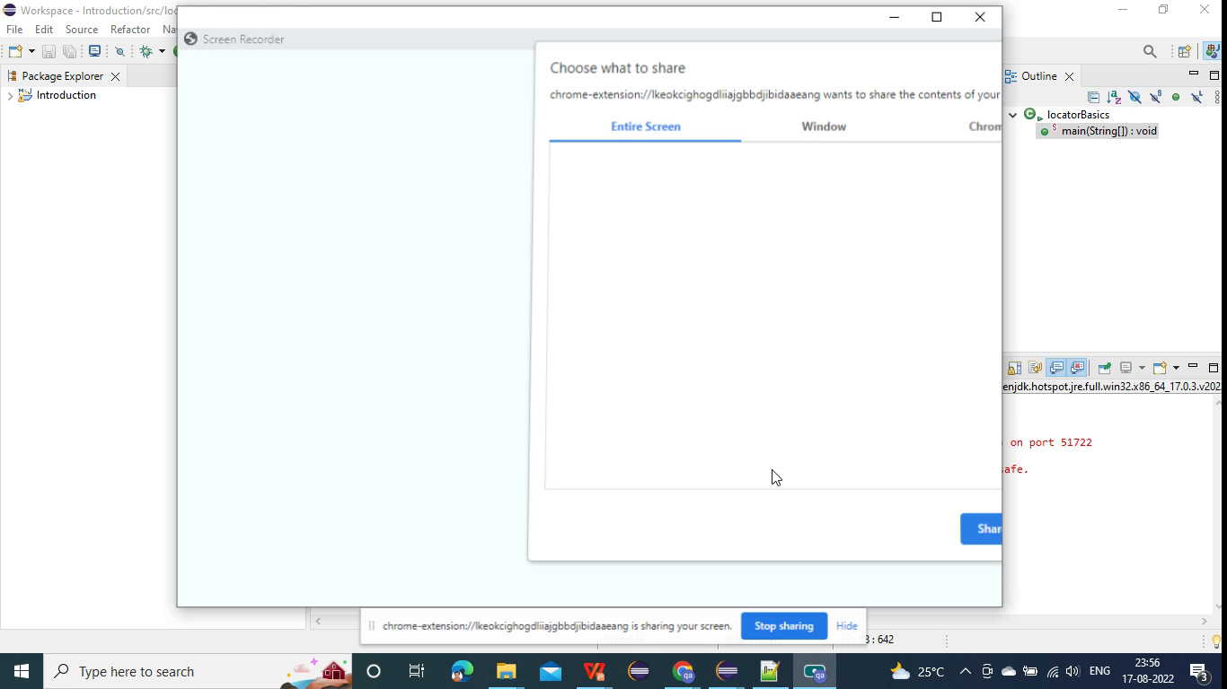
Locating elements using locators

Slide 6
Plug ins for locating elements
Locators must be unique
Install the following plugins for chrome browser in order to check the uniqueness of the locators
Chropath
SelectorsHub
Open any of plugin and copy the css or xpath created
It will show whether the created css is unique or not
Apart from the above mentioned plugins, we can also check the xpath and css correctness from the console in the developer tools
For css type in $(‘<css>’)
For xpath type in $x(“<xpath>”)

